Slide 1


Vicente Espinosa
29-07-2022

Slide 2

Outline
Executive Summary
Introduction
Methodology
Results
Conclusion
Appendix

Slide 3
Executive Summary
Summary of methodologies
Data Collection
Data Wrangling
Exploratory Data Analysis (EDA)
Visualization
Predictive Models
Summary of all results
Records collected from Falcon 9 landing outcomes
Four launch sites on south US which have fast access
Not clear relation between payload and other variables, except for flight numbers
High success rate of landing
Models predict with the same accuracy unknow data

Slide 4
Introduction
Companies are making space travel affordable
Space X has been the most successful, mainly due to cost reductions by recovering phase one stage
The objective is to determine each price launch and if phase one will be reused due to a machine learning prediction on public information

Slide 5

Section 1

Slide 6
Methodology
Executive Summary
Data collection methodology:
Data collected by SpaceX API and webscraping
Perform data wrangling
Exploratory data analysis (EDA) with python and determine labels for training supervised model
Perform exploratory data analysis (EDA) using visualization and SQL
Perform interactive visual analytics using Folium and Plotly Dash
Perform predictive analysis using classification models
How to build, tune, evaluate classification models

Slide 7
Data Collection
The data was requested to the Space X API and then cleaned.
Also, it was webscraped from Falcon 9 historical launch records from a Wikipedia page
SpaceX API
Data
Webscraping

Slide 8
Data Collection - SpaceX API
The data was requested to the Space X API
Follow the next link to see the code used
GitHub URL
Request to SpaceX API
Response to dataframe
Extract variables of interest
Filter dataframe
Resulting dataframe with Falcon 9 records

Slide 9
Data Collection - Scraping
Request Wikipedia
The data was webscraped from Falcon 9 historical launch records from a Wikipedia page
Follow the next link to see the code used
GitHub URL
BeautifulSoup on Response
Extract variables of interest
Create dataframe by parsing HTML tables
Resulting dataframe with Falcon 9 records

Slide 10
Data Wrangling
Exploratory Data Analysis (EDA) with python to find some patterns in the data and determine what would be the label for training supervised models
GitHub URL
Classifying records by landing outcomes
Transforming values into workable types
Counting values from variables of interest
Search for null values

Slide 11
EDA with Data Visualization
Mainly scatter plots to see the different relations between the variables of interest.
A bar chart to see the relation between success and orbit type.
A line plot to analyze the success yearly trend
GitHub URL

Slide 12
EDA with SQL
Determine unique launch sites
Determine total payload mass per client and avg payload mass per booster version
Find date, booster version, payload mass and type of success and failure records between dates and/or booster version
GitHub URL

Slide 13
Build an Interactive Map with Folium
The map has markers, circles, clusters and lines
Markers shows landing outcome, classified by success (green) and failure (red)
Circles show the launch site
Clusters are made by the markers inside the launch site circles
Lines show distances between a launch site and nearest coastline, railway, highway and city
GitHub URL

Slide 14
Build a Dashboard with Plotly Dash
Dashboard contains
Dropdown of the launch sites to select between all or each site, modifying in real time the graphs
Pie chart showing success failure ratio for selected sites
Range slider to select payload to limit the range of the payload mass showed in the scatter plot
Scatter plot between payload mass and mission outcome for selected site to analyze possible correlations between payload and mission outcome.
GitHub URL

Slide 15
Predictive Analysis (Classification)
Gridsearch for best hyperparameters
for Logistic regression, SVM, Decision tree and k nearest neighbour
Selecting the independent variables and the dependent one
Predict and evaluate the models using the test data set
Split data into training and testing sets
Loading the dataframe
GitHub URL

Slide 16
Results
Exploratory data analysis results
Interactive analytics demo in screenshots
Predictive analysis results

Slide 17

Section 2

Slide 18
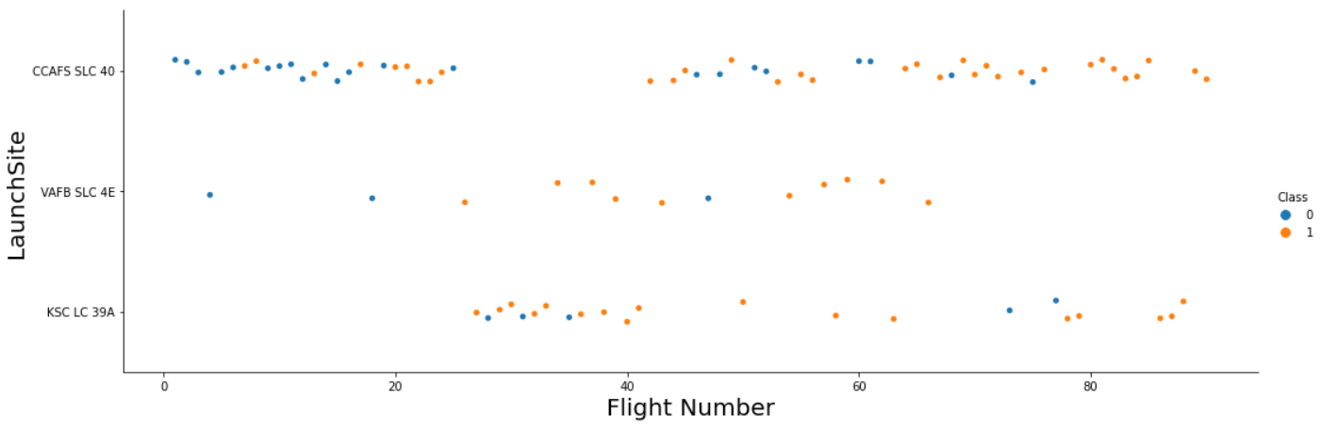
Flight Number vs. Launch Site
Relation between Flight Number success (Class 1) per Launch Site

Slide 19
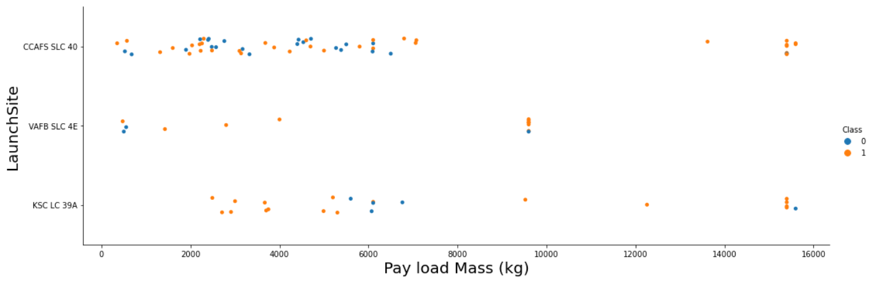
Payload vs. Launch Site
Relation between payload mass success (Class 1) per Launch Site

Slide 20
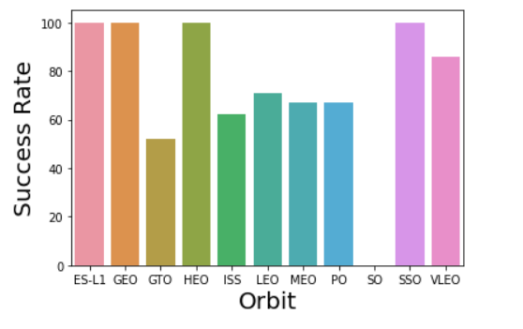
Success Rate vs. Orbit Type
Bar chart showing the success rate per orbit

Slide 21
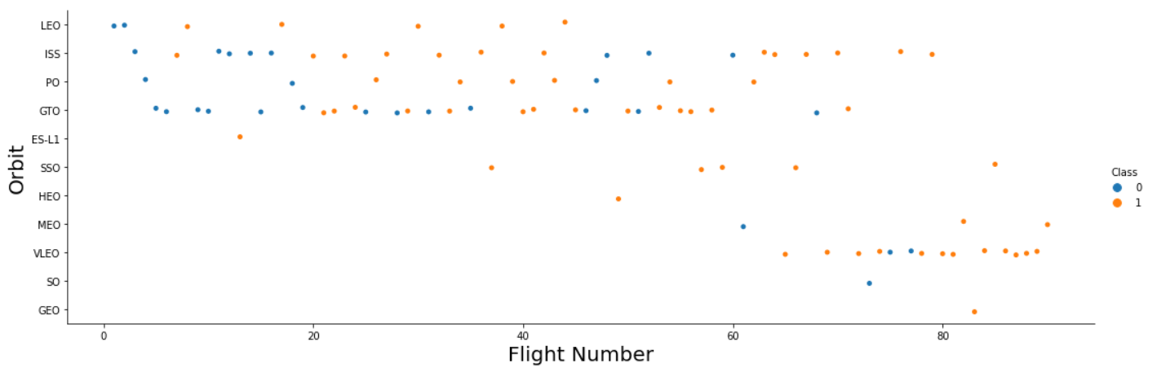
Flight Number vs. Orbit Type
Relation between Flight Number success (Class 1) per orbit

Slide 22
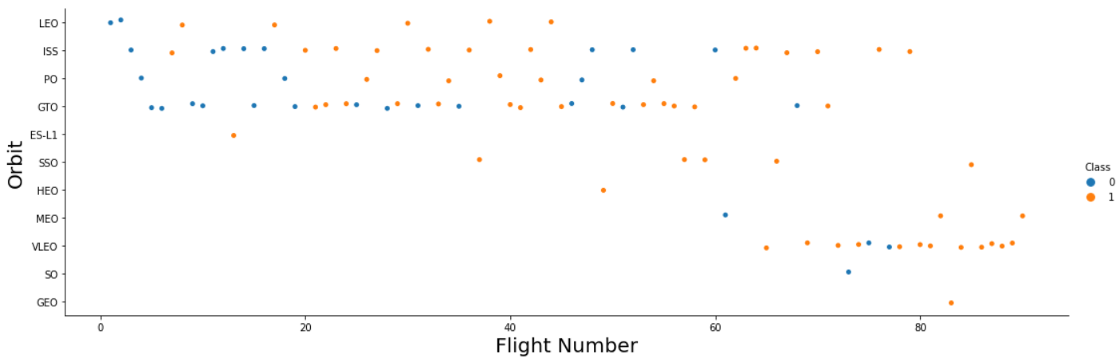
Payload vs. Orbit Type
Relation between Flight Number success (Class 1) per orbit

Slide 23
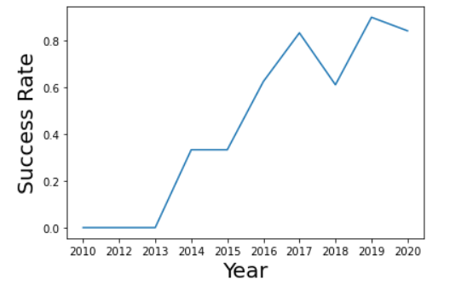
Launch Success Yearly Trend
Line chart of yearly average success rate showing the general trend
Upward trend since 2013

Slide 24
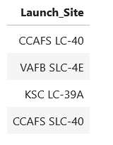
All Launch Site Names
Names of the unique launch sites
We have four launch sites

Slide 25
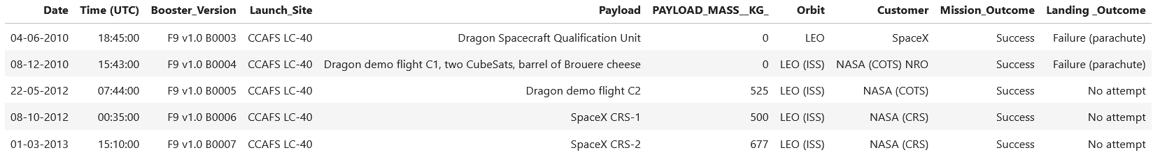
Launch Site Names Begin with 'CCA'
5 records where launch sites begin with `CCA` alluding to Cabe Canaveral launch site

Slide 26
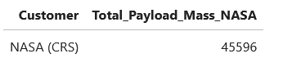
Total Payload Mass
Total payload carried by boosters from NASA

Slide 27
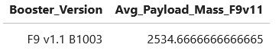
Average Payload Mass by F9 v1.1
Average payload mass carried by booster version F9 v1.1

Slide 28
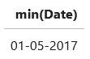
First Successful Ground Landing Date
First successful landing outcome on ground pad date

Slide 29
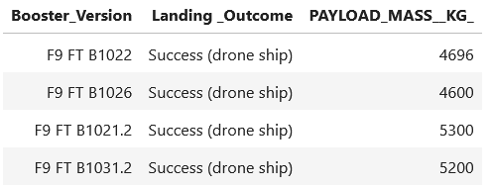
Successful Drone Ship Landing with Payload between 4000 and 6000
Boosters which have successfully landed on drone ship and had payload mass greater than 4000 but less than 6000

Slide 30
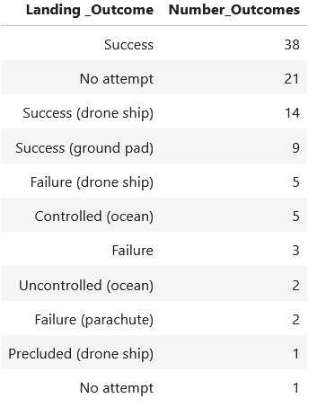
Total Number of Successful and Failure Mission Outcomes
Total number of successful and failure mission outcomes
Showing a great number of successes over failures

Slide 31
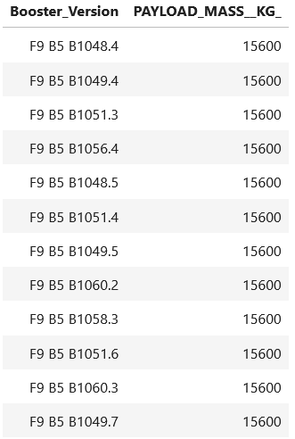
Boosters Carried Maximum Payload
Booster which have carried the maximum payload mass
Corresponding to B5 version

Slide 32
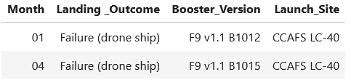
2015 Launch Records
Failed landing outcomes in drone ship, their booster versions, and launch site names for in year 2015

Slide 33
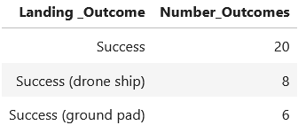
Rank Landing Outcomes Between 2010-06-04 and 2017-03-20
Landing outcomes between the date 2010-06-04 and 2017-03-20, in descending order

Slide 34

Section 3

Slide 35
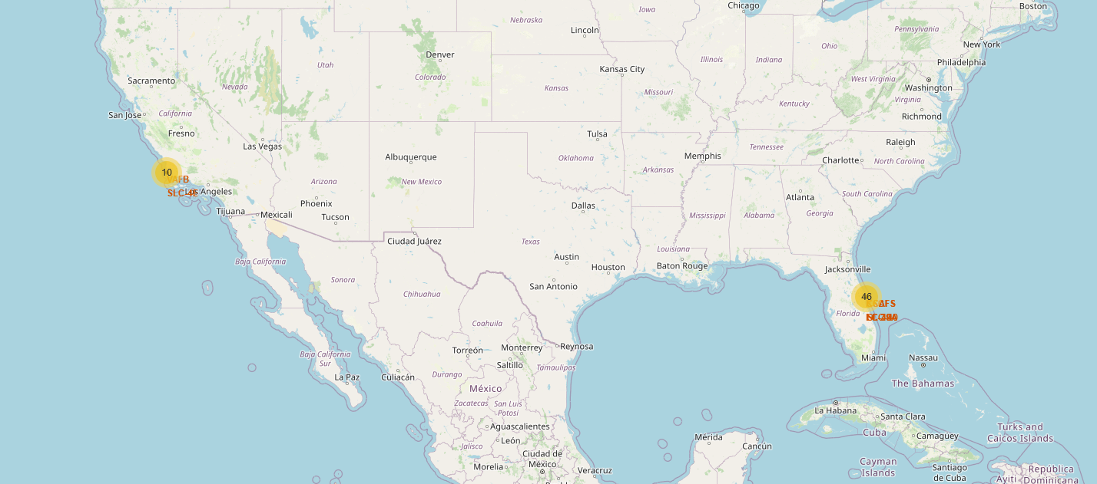
Launching Sites
All launch sites located at south states of the US
Launches in California and Florida
Mainly from Florida with 82% of launches

Slide 36
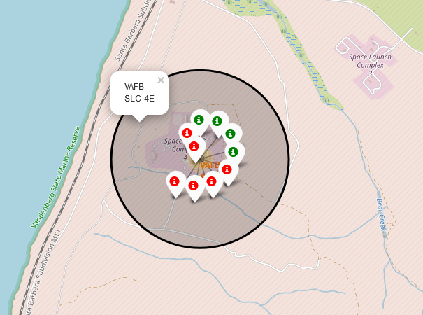
VAFB SLC-4E
Launches from Vandenberg Space Launch Complex, California
Classified by landing outcomes, where success is green and failure red
40% of success

Slide 37
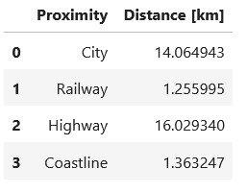
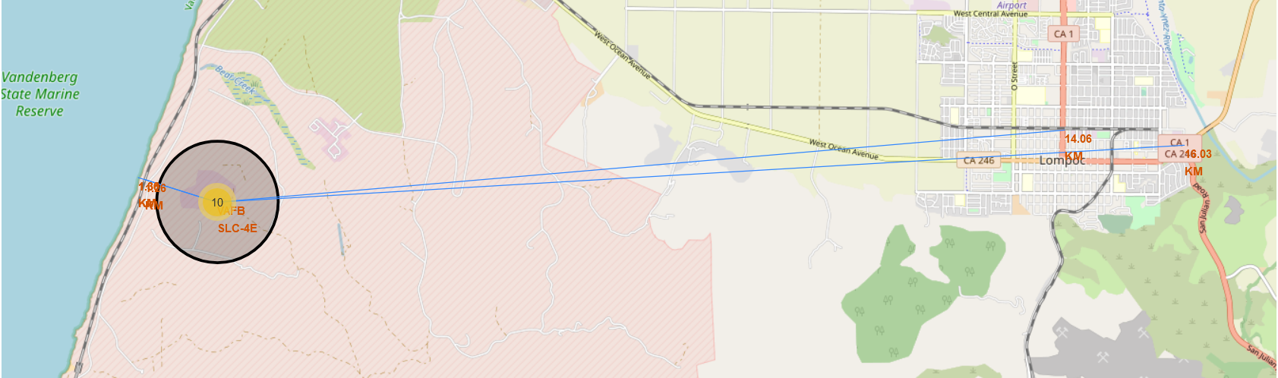
VAFB SLC-4E Proximities
Proximities to Vandenberg Space Launch Complex
Distances shown in the table

Slide 38

Section 4

Slide 39
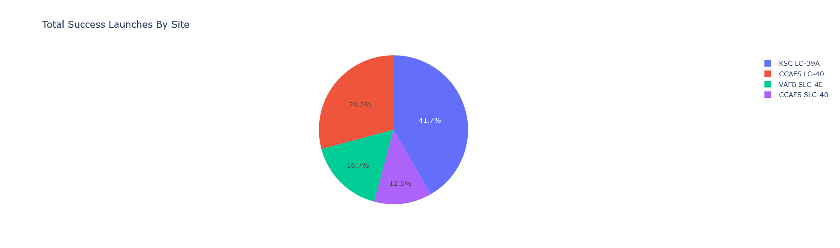
Success Launches by Site Pie Chart
Success count of all launch sites
Better success ratio from KSC LC39A
Worst success ratio from CCAFS SLC-40

Slide 40
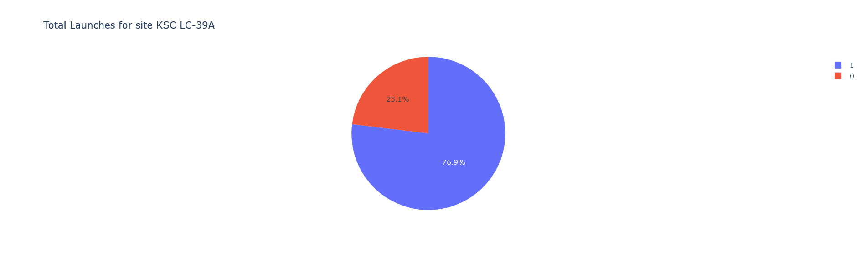
Success Launches from KSC LC-39A
Pie chart of the best success ratio launch site
Proving a near 77% successful landing outcomes

Slide 41
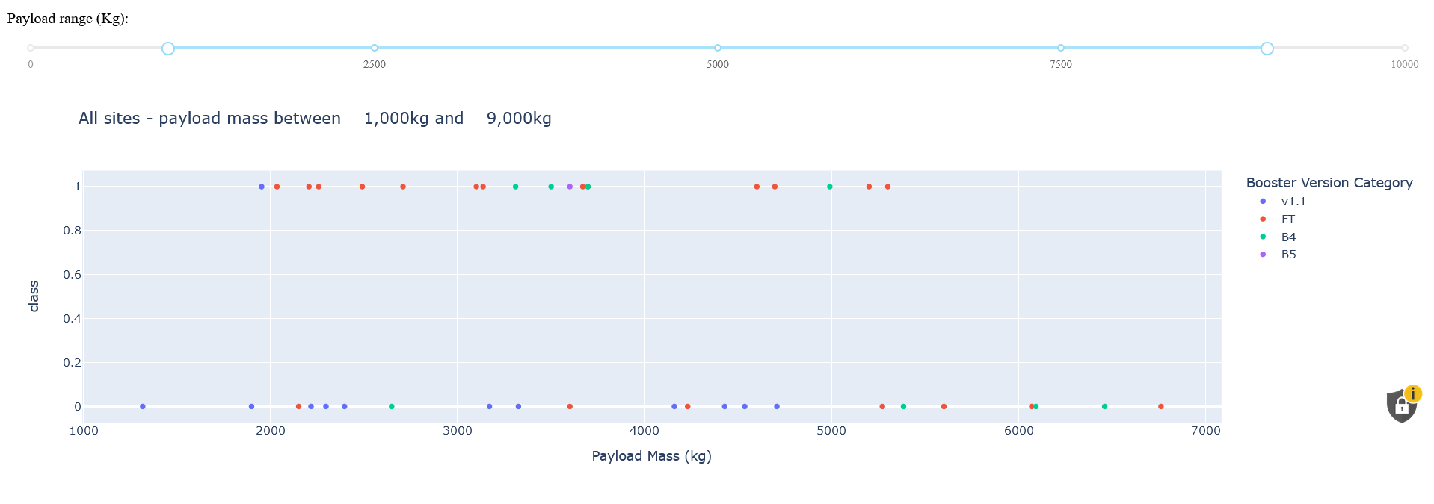
Payload vs. Launch Outcomes Scatter Plot
Scatter plot doesn’t show a clear relation between payload, booster version and success rate.

Slide 42

Section 5

Slide 43
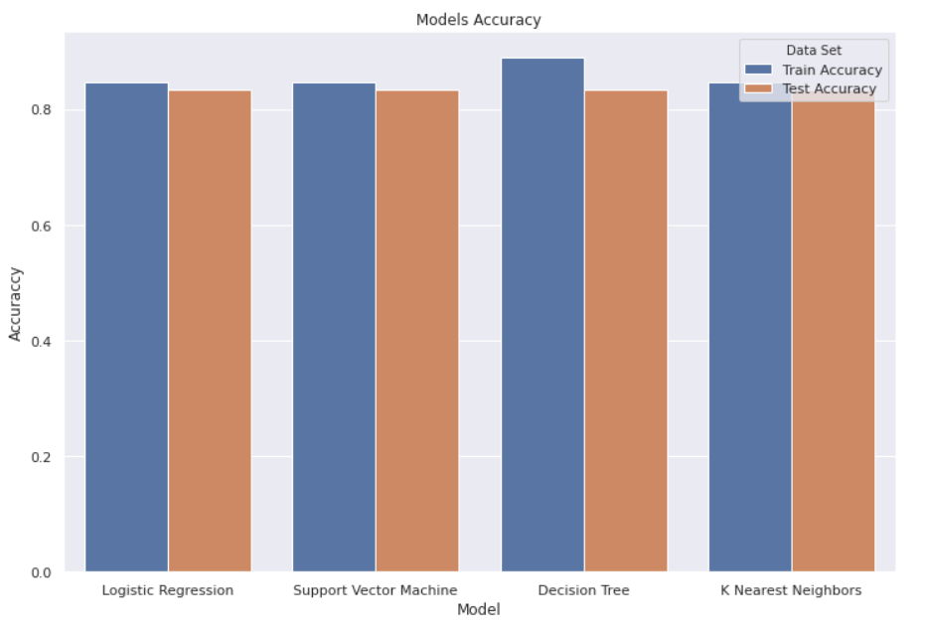
Classification Accuracy
All the models present the same train accuracy, except for the decision tree which is a little bit higher
The four models presents the same test accuracy
The models will perform the same with the unknow data, except for decision tree which could capture noise

Slide 44
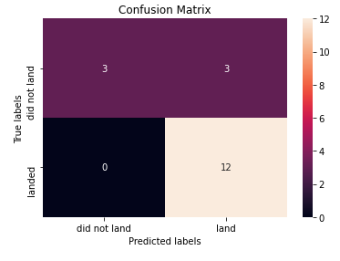
Confusion Matrix
All the models show the same confusion matrix
This confusion matrix show a good accuracy for successful landing outcome
Also, show accuracy of 50% in failures in lading outcomes

Slide 45
Conclusions
Only four launching sites
High overall success in landing outcomes
Landing outcomes have a successful upward trend since 2013
Not clear correlation between orbit and successful landing, same for payload, booster version and success rate
Launch sites on south of the US (Florida and California), nearest the Ecuador
Launch sites have proximities with coastlines, railways, highways and a city
Most successful landing outcome rate is from KSC LC39A and worst from CCAFS SLC-40
The predictive models perform the same with the unknow data, except for decision tree which could capture noise
All the models show the same confusion matrix which has a 100% accuracy for successful landing outcomes and 50% for failure ones.
This prove that phase one have a high successful rate to be recovered

Slide 46
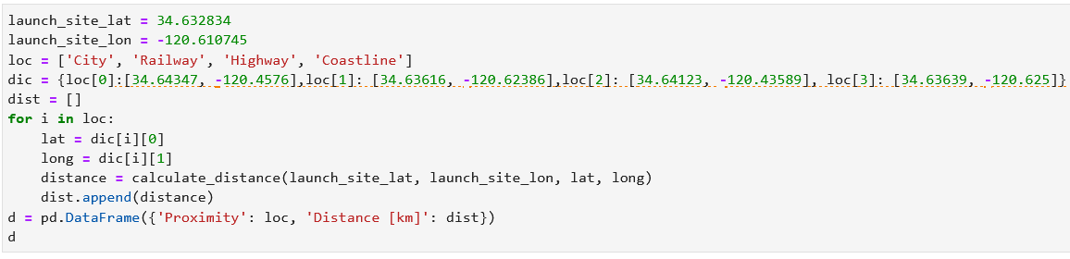
Appendix
Code for proximities table

Slide 47
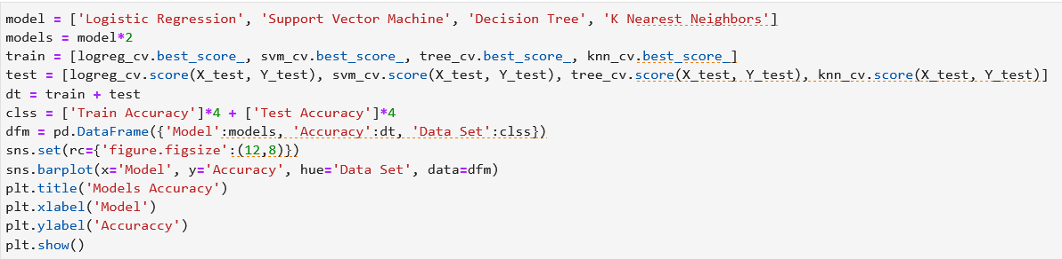
Appendix
Code for model accuracy for all built classification models

Slide 48


